Slide 1
Scientific Conference on the Climate Change in the Caspian Sea region
27-28 October 2021
Outcomes, conclusions, new paths
Notes:
Scientific Conference on Climate Change in the Caspian Sea Region was held on 27-28 October 2021 under the auspices of the interim Secretariat of the Tehran Convention and the Coordinating Committee on Hydrometeorology and Pollution Monitoring of the Caspian Sea (CASPCOM).
It was one of the first scientific conference in the region with such a broad participation of the various stakeholders.

Slide 2
Conference sections
Climate of the Caspian Sea region and its changes in the 21st century
Caspian Sea level change: analysis, modeling, and long-term projection
effects of climate change on the ecosystem and biodiversity of the Caspian Sea
Adaptation to climate change in the Caspian Sea region
Notes:
The main thematic focus areas of the Conference on the slide:
- Climate of the Caspian Sea region and its changes in the 21st century
- Caspian Sea level change: analysis, modeling, and long-term projection
- Effects of climate change on the ecosystem and biodiversity of the Caspian Sea
- Adaptation to climate change in the Caspian Sea region
Out of these focus areas the most attended and vividly discussed was the 2nd focus area whereas the last one on Adaption to climate change in the region was the least popular. This is due to the absence of the adaption measures in place in the quickly changing ecosystem.

Slide 3
Key figures
More than 80 abstracts received by the Organizing Committee
40 abstracts selected to be presented at the Conference
More than 100 participants and attendees
Hybrid format: on site in Astrakhan (Russia) and online
Participants from all the five Caspian littoral states and other countries and scientific centers: MARUM – Cen­ter for Mar­ine En­vir­on­mental Sci­ences (Germany), EMODnet (European Marine Observation and Data Network), etc.
Notes:
Organizing Committee of the Conference, consisting of the Caspian nominated experts, received more than 80 abstracts from scientists and experts from five Caspian littoral states and from scientific institutions. Most of the abstracts came from the Caspian based scientific institutions as well as other European based institutions.
The Conference was held in hybrid format which allowed for broad participation and reduced the organizational costs. Together with the onsite in Astrakhan (Russian Federation) and remote participants and brought together more than 100 experts and attendees. In her opening remarks Dr. Andrea Hinwood, UNEP Chief Scientist stated that “This Scientific Conference is a first step towards more institutionally established scientific collaboration in the Caspian Sea region “ whereas and Dr. Hoesung Lee, the Chair of Intergovernmental Panel on Climate Change (IPCC) highlighted “The Caspian Sea with its unique and isolated ecosystem, its abundant oil and gas resources, and its long history of water level fluctuations deserves special attention in the science of assessing and addressing the impact of climate change.

Slide 4
Post-Conference survey results
100% positive reviews and appreciation for the organization of the event
Expressed wish to organize this kind of Conference at least once in three years
Demanding request for more events of this type in the region
Scientific events on other relevant topics as well: fisheries, sea level fluctuations, adaptation to climate change, conservation of Caspian seals
Notes:
After the Conference the Organizing Committee carried out a survey and the results exceeded all expectations: all the participants assessed the Conference as very positive and useful experience. They pointed out the necessity of organization of similar Conference at least once in three years. They also noted a lack of regional scientific cooperation in climate change and environmental studies and raised a large request for similar events on other subjects.
Other related topics that were proposed as potential thematic focus for following activities that were mentioned by participants were 1) fisheries, 2) sea level fluctuations, 3) conservation of Caspian seals and 4) adaptation measures

Slide 5
Recommendations
Climate change forecasting in the Caspian Sea region
Caspian Sea level monitoring, modeling and forecasting
Conservation and protection of the ecosystem and biodiversity of the Caspian Sea
Conservation of the population of the Caspian seal
Minimizing the adverse effects of and adaptation to the climate change in the Caspian Sea region
Notes:
One of the most important outcomes of the Conference were also the list of recommendations elaborated by the participants. On the slide you can see core areas of these recommendations. These recommendations were subsequently brough to the attention of the Caspian Governments via the Tehran Convention mechanism. The proceedings of the Conference are captured in the online publication available in EN and RU. The document can be found on the Tehran Convention website.

Slide 6
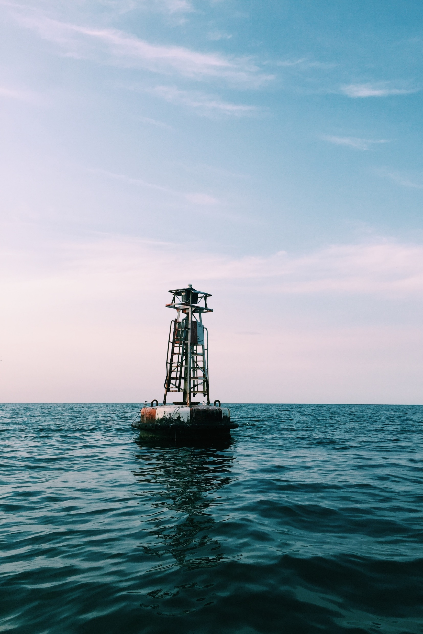
Scientific Network of the Caspian Sea Region
Recommendation of the Conference to establish “a network of scientists supported by a thesaurus of climate change related research, to advise and assist the Parties to the Tehran Convention and members of CASPCOM in the development and implementation of their climate change related policies and cooperation”.
Notes:
Crucial and the most voiced recommendation was the need for more institutionalized scientific cooperation in the Region, and for that purpose to establish “a network of scientists supported by a thesaurus of climate change related research, to advise and assist the Parties to the Tehran Convention and members of CASPCOM in the development and implementation of their climate change related policies and cooperation”.

Slide 7
Scientific Network of the Caspian Sea Region
Great demand for such a scientific community in the Region
Terms of Reference for the Network are currently discussed by Caspian littoral States
National initiatives are important but regional scientific cooperation is lacking
Objectives:
Gather existing knowledge and bring more experts outside the Caspian Sea region
Improve knowledge and understanding of the processes
Notes:
Establishment of such a Network would help to gather and systematize the existing knowledge and best practices of Caspian littoral States as well as to invite for cooperation more experts from outside the region to share their expertise. The creation of the Network was also welcomed and supported by the Sixth Meeting of the Conference of the Parties to the Tehran Convention (COP6) held in Baku in October 2022.
The working mechanisms as well as the specific objectives are developed jointly by the TC Secretariat and CASPCOM. They will be shortly presented to the Caspian littoral states for their review and consideration.
It is important to note that there are some very important national initiatives, such as recent Expert group meeting to study the causes of Caspian Sea level fluctuations held in Baku in November, yet but there is a lack of institutionalized scientific cooperation on a regional level.

Slide 8
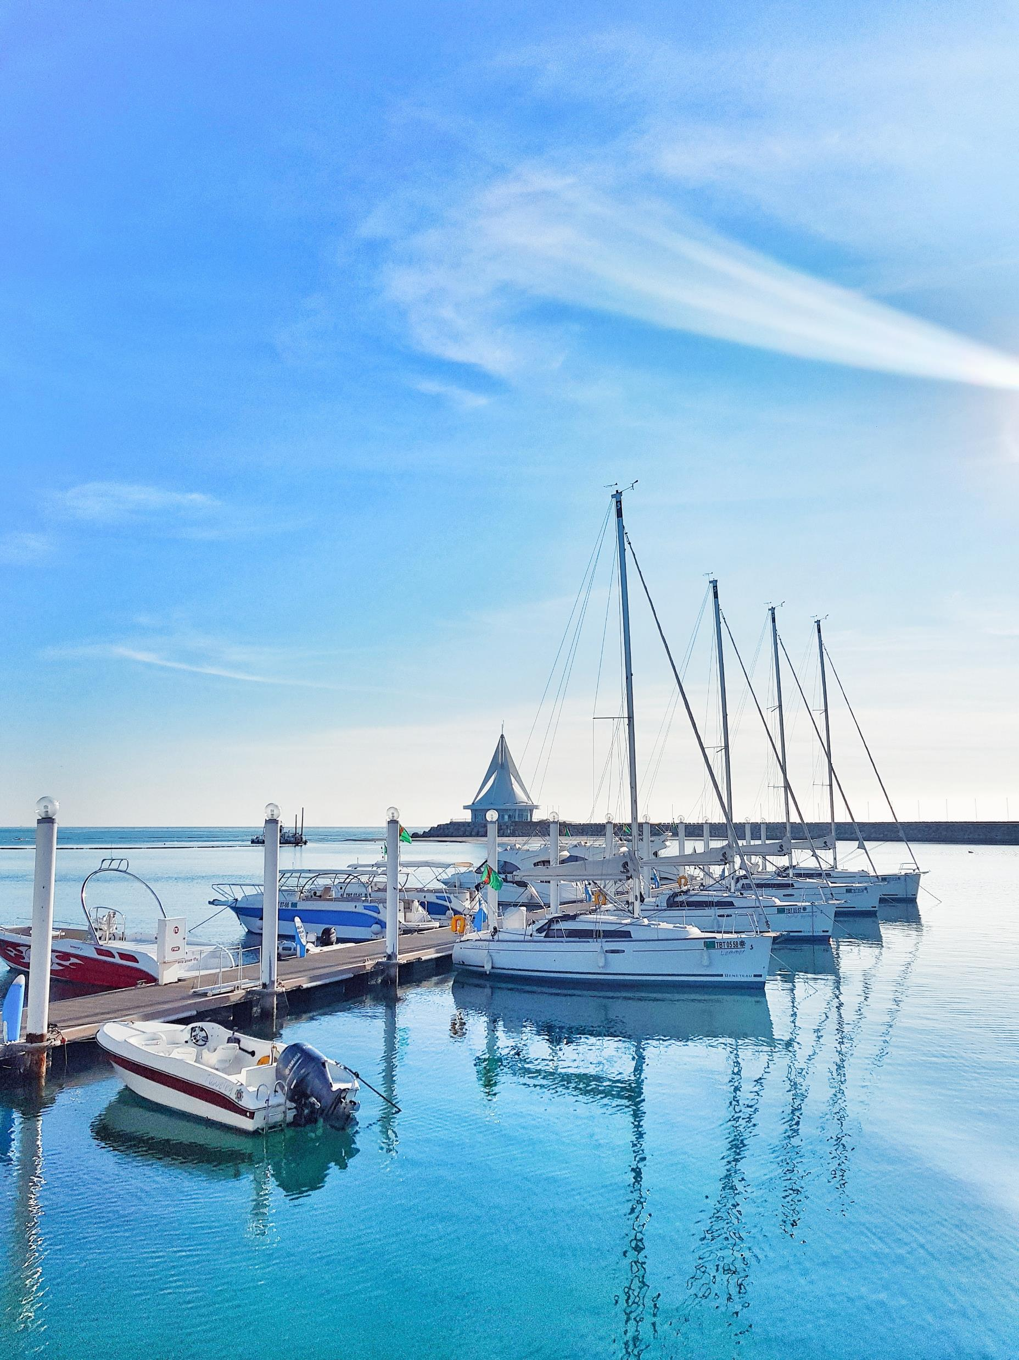
Feeding the project preparation activities:
Outcomes of the scientific research provided by the participants of the Scientific Conference were used to elaborate the Adaptation Fund project proposal for Azerbaijan and Iran “Urbanisation and Climate Change Adaptation in the Caspian Sea Region”, in particular, new data on the Caspian Sea level forecasting, climate change consequences and hazardous climate-related events
Notes:
The result of scientific research was not only valuable for the knowledge-building, but also for formulating the project documents on adaptation in climate change. Outcomes of the scientific research provided by the participants of the Scientific Conference were used to elaborate the Adaptation Fund project proposal for Azerbaijan and Iran “Urbanisation and Climate Change Adaptation in the Caspian Sea Region”, in particular, new data on the Caspian Sea level forecasting, climate change consequences and hazardous climate-related events. The project is under consideration of the Adaptation Fund, and you will hear the presentation delivered by our colleague from UN Habitat later

Slide 9
To conclude
Caspian Sea Water Fluctuations poses enormous challenge
High demand for the regional scientific cooperation
Science -Policy platform enabling climate adaptation
Integrated planning and adaptation
Notes:
To conclude, I would like to draw your attention to the following four points.
1. The Caspian Sea Water fluctuations is a unique phenomenon.
The recent Climate change driven decline poses an enormous threat to the sustainable development of the region.
2. There is a great demand for the enhanced scientific cooperation in the Caspian Sea region. The issue of the Caspian Sea level fluctuations should be further researched in a coordinated way by the experts from the region.
3. Science -Policy platform enabling climate adaptation is key.
We in UNEP see the Science-policy platform acting as a bridge between the scientific community and policymakers, ensuring that climate adaptation strategies are evidence-based, responsive, and capable of addressing the complex challenges posed by climate change. This collaboration is vital for building resilience and fostering sustainable development in the face of a changing climate.
4. Integrated planning and adaptation
Integrated planning and adaptation are interconnected processes that involve considering climate change impacts across various sectors, engaging diverse stakeholders, and implementing cohesive strategies to build resilience and sustainability in the face of a changing climate. Involvement and support of the global funds are needed to provide catalytic support to the Caspian countries in these changing times.

Slide 10
Thank you

