Slide 1
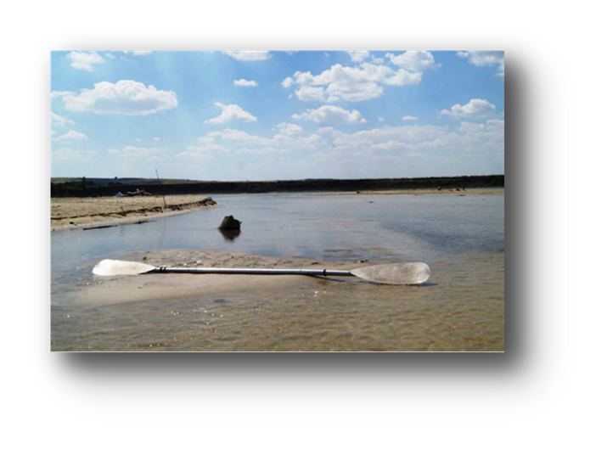
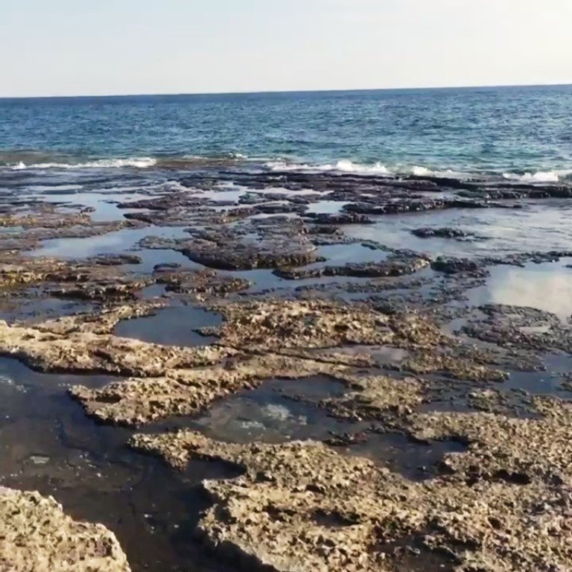
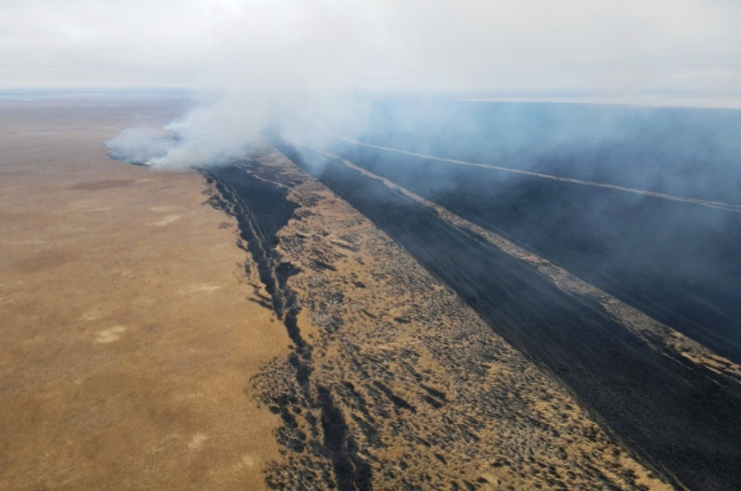
IMPACT OF REGIONAL CLIMATE CHANGES ON THE CASPIAN SEA LEVEL
Elena Ostrovskaya, PhD
Coordinator of the CASPAS (CASPCOM)
Notes:
Ladies and gentlemen, distinguished delegates,
First of all, on behalf of the Secretariat of the Framework Convention for the protection of marine environment of the Caspian Sea I would like to express words of appreciation to the Republic of Azerbaijan for hosting this side event.

Slide 2
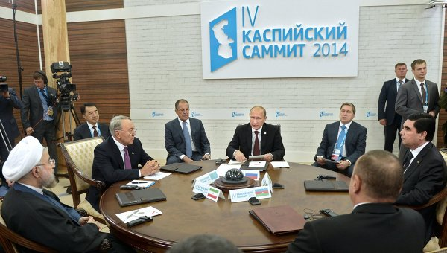
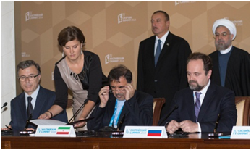
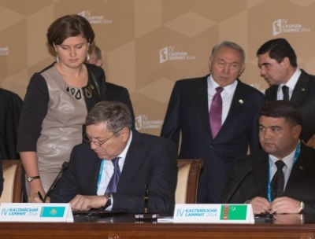
International cooperation in hydrometeorology and climate in the Caspian Sea
Agreement on Cooperation in the field of Hydrometeorology of the Caspian Sea (2014) Coordination Committee on Hydrometeorology of the Caspian Sea (CASPCOM)
Observation network of the Caspian Sea:
Observation data at 26 marine stations within the framework of the international data exchange through the CASPCOM
The main goal of the Agreement is to create and develop a regional system for getting and exchanging data on the Caspian Sea state of environment
Signing of the Agreement at the IV Caspian Summit in Astrakhan, 2014
Notes:
I bring to your attention the evolving dynamics of the Caspian Sea, a body of water with a rich and varied history spanning centuries. The printout of the presentation was prepared by the colleagues from CASPCOM with who the Tehran Convention enjoys great collaboration and has signed Memorandum of Understanding. The several points which I want to highlight now are based on our collaboration.

Slide 3
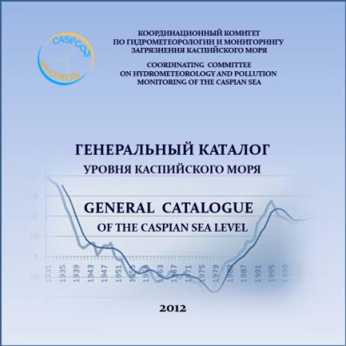
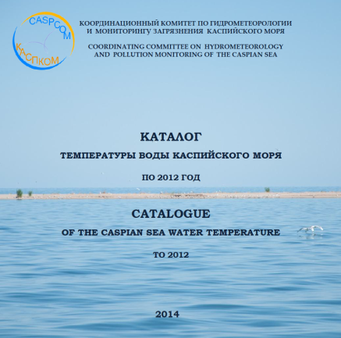
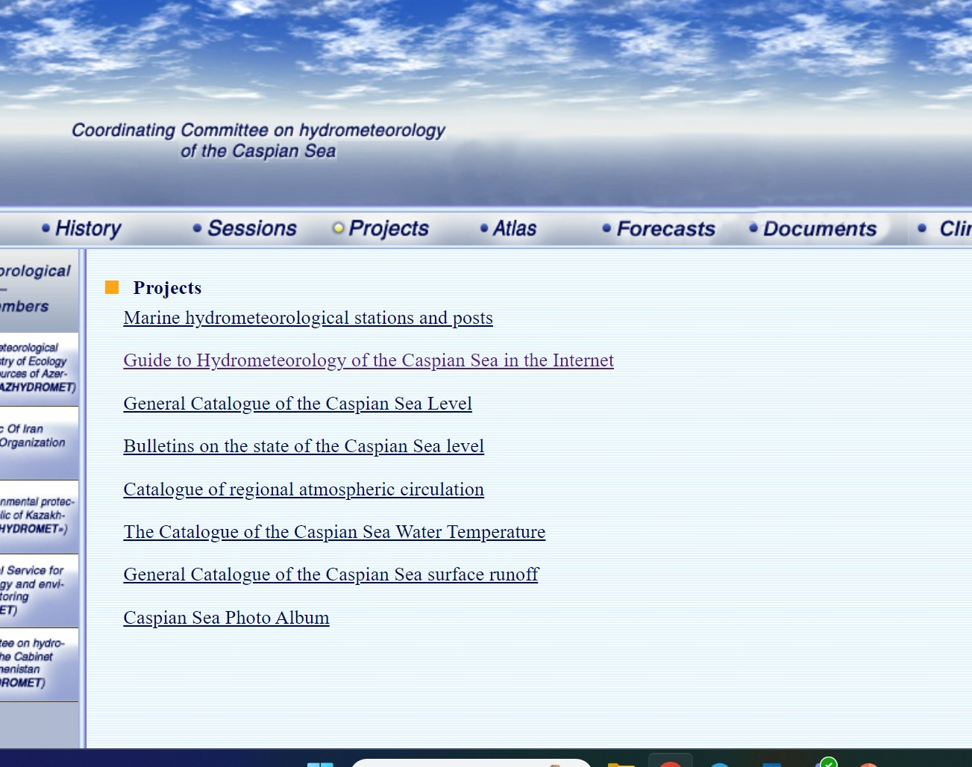
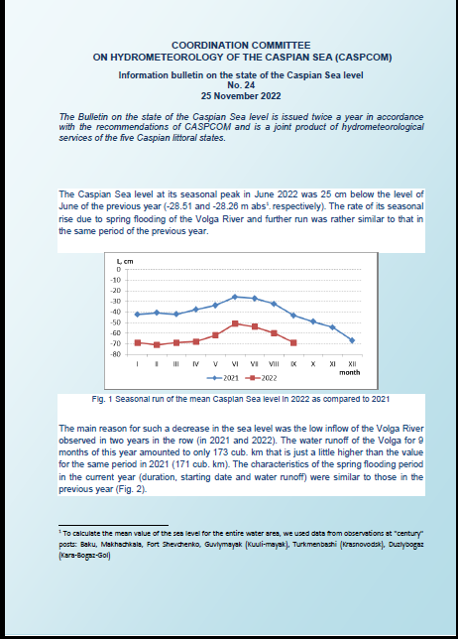
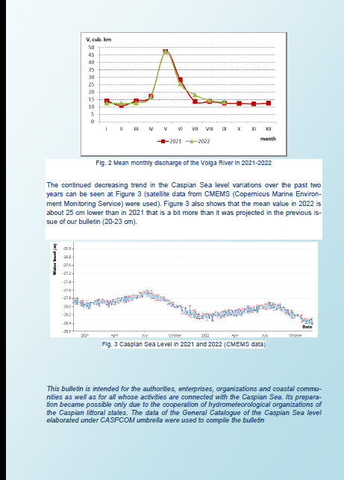
Information resources of the CASPCOM
Catalogues of observation data (regional atmospheric circulation, sea level, river flow, water temperature, water salinity, air temperature)
CASPCOM website
www.caspcom.com
Information and analytical products (bulletins on the state of sea level, climate bulletins)
Notes:
The Caspian Sea, distinct in its separation from the World Ocean, has demonstrated a remarkable sensitivity to shifts in climate conditions within its basin.
Over the course of instrumental observations, the Caspian Sea's level has undergone fluctuations of 4 meters, ranging from -25.3 meters in the 1800s to -29.0 meters in 1977. Following a rise in the 1980s and early 1990s, the sea's level now approaches the critical thresholds of the late 1970s, reaching -28.9 meters below sea level in 2023. Projections indicate a continued decline in the next decade.

Slide 4
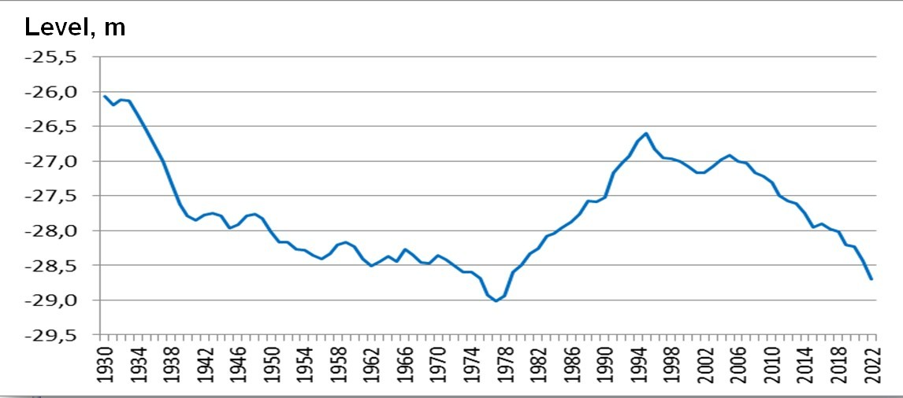
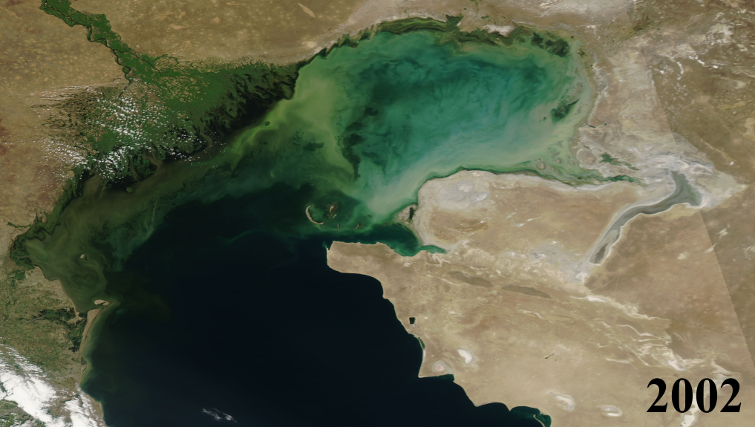
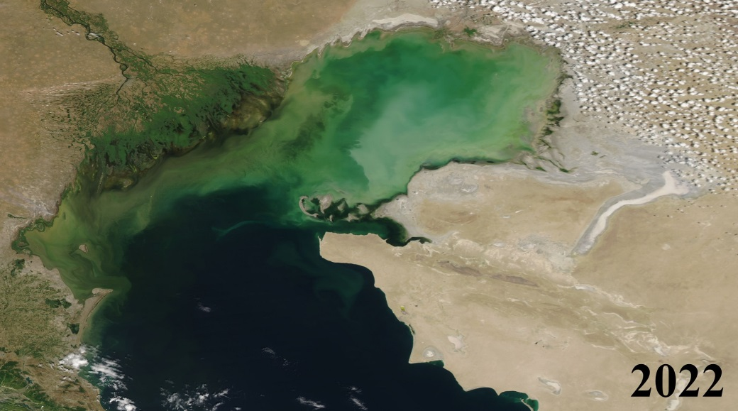
Caspian Sea level fluctuations
Caspian Sea level decline has reached 2m since 1996
Reduction of the Caspian sea water surface area by 29,000 km² by 2023
Source: Kazhydromet
Notes:
The prevailing cause behind this diminishing level lies in the altered water balance of the Caspian Sea, marked by increased evaporation and a reduction in inflow such as precipitation and river runoff. Long-term observational data reveals the substantial impact of contemporary global climate changes on the Caspian region, particularly affecting humidity, temperature conditions, and the ice regime in its northern expanse.

Slide 5
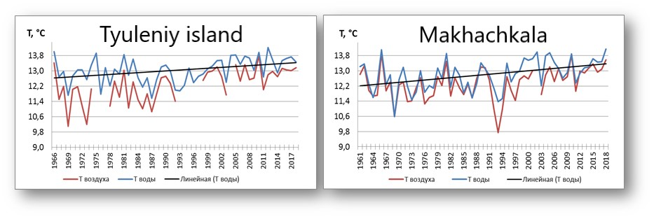
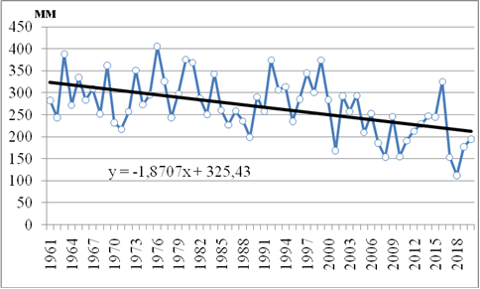
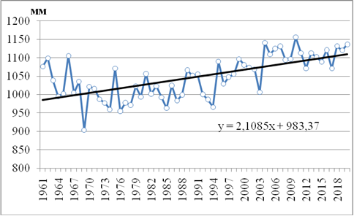
Changes in climate characteristics
Air and water temperature growth
Decline in precipitation
Increase of evaporation
Notes:
Observations from coastal stations indicate a 1.0°C rise in the average annual air temperature over the past 30 years, translating to a 0.5°C increase in the surface water layer. This warming trend correlates with diminishing precipitation and increased evaporation rates, with precipitation decreasing by 1.9 mm per year and evaporation rising by an average of 2.1 mm annually.

Slide 6
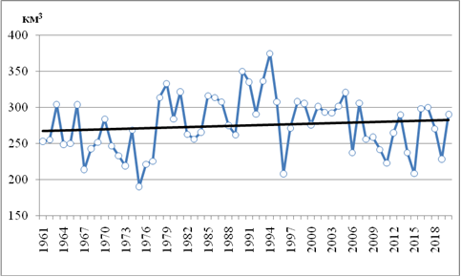
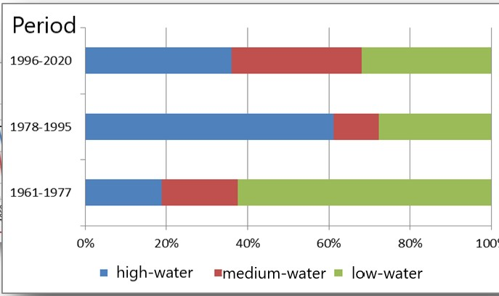
Changes in water runoff of the Caspian Sea basin rivers
Water runoff in the Caspian Sea basin
Period (in years) | Volga, km³ | Chalus, km³ | Kharaz, km³ | Kura, km³ | Podprud, km³ | Sefid-rud, km³ | Sudak, km³ | Terek, km³ | Ural, km³
1961-1977 | 219,7 | 0,40 | 1,09 | 15,7 | 0,52 | 3,47 | 4,65 | 5,66 | 7,29
1978-1996 | 262,5 | 0,46 | 0,87 | 13,8 | 0,46 | 4,48 | 4,65 | 5,73 | 8,84
1997-2020 | 242,1 | 0,38 | 0,89 | 10,9 | 0,45 | 1,62 | 4,89 | 8,41 | 6,88
Water runoff of 9 rivers
Number of high-water years has declined
Notes:
In tandem with reduced precipitation and warming, the water flow from Caspian basin rivers has notably decreased. The average annual total river flow into the sea has diminished by approximately 35 km3 compared to the period of 1978-1995.

Slide 7
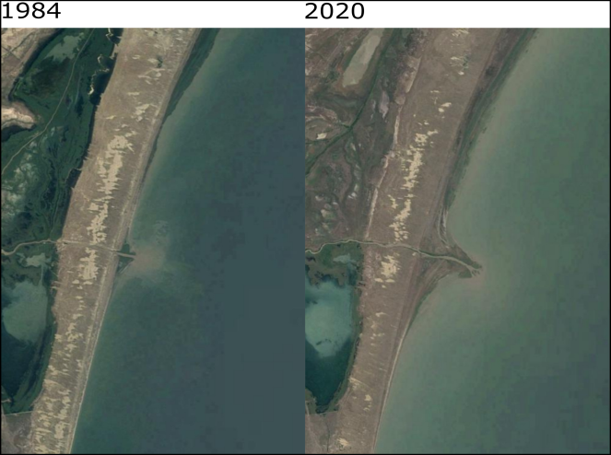
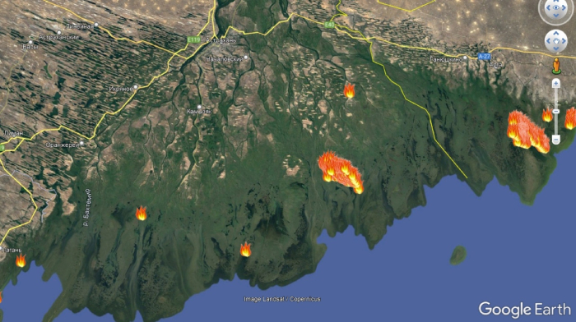
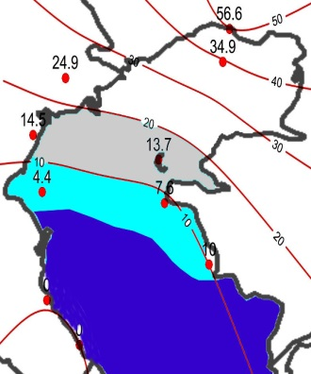
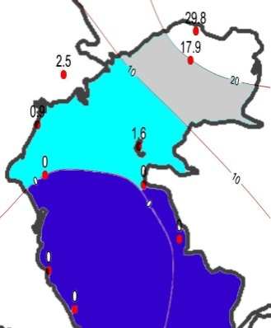
Impact of climate change on marine and coastal ecosystems
Drainage of the coastal zone of the Caspian sea
Terek
Fires in Volga River delta
Desertification, shrinkage of coastal zones, bays, wetlands, river deltas;
Changes in ice conditions (forecast)
Threat to the biodiversity of the region, especially the Caspian Seals population due to warming winters and changing ice conditions
1981–2010
2071–2100
Average max thickness of the ice (cm)
Source: Kazhydromet
Notes:
Furthermore, winters in the northern Caspian region have experienced significant warming, leading to softer ice conditions. The frequency of severe winters has dwindled, and the average number of ice days during the ice period has substantially decreased. The timing of complete ice clearance from the sea has shifted to earlier dates, accompanied by diminishing ice distribution areas and thinner ice cover.

Slide 8
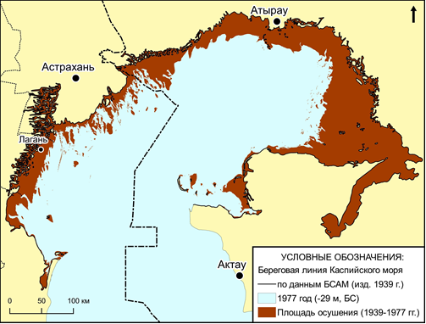
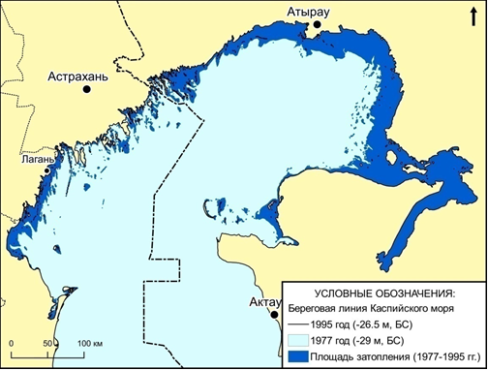
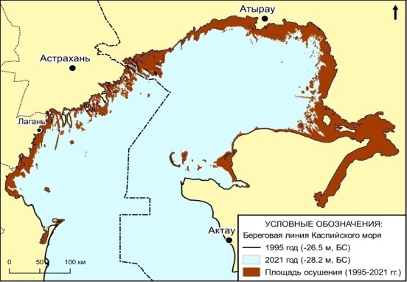
Long-term fluctuations in sea level are cyclical and caused by natural causes
Fluctuations in the level of the Caspian Sea according to historical data
Changes in the coastline in the northern part of the Caspian Sea in different periods
1930-1977
1978-1995
1996-2021
Notes:
It is imperative to recognize that the long-term fluctuations in sea level, viewed in a historical context, follow cyclical patterns inherent to climate variability. This cyclicality should be duly considered in the formulation of adaptation strategies. In this context, the timely provision of accurate hydrometeorological information plays a pivotal role in facilitating effective decision-making and the development of climate change adaptation plans.

Slide 9
To adapt to climate change, it is necessary:
to consider the cyclical nature of long-term fluctuations of the Caspian Sea level in territorial planning;
to develop a regional observation system;
improve the quality and reliability of hydrometeorological and climate information;
strengthen international data exchange within the framework of the CASPCOM, Tehran Convention and other regional agreements
Notes:
I commend the collaborative efforts of the Caspian littoral countries under the Agreement on Cooperation in the Field of Hydrometeorology of the Caspian Sea and the Coordinating Committee on Hydrometeorology (CASPCOM). These endeavors contribute significantly to addressing the challenges posed by the changing climate conditions in the Caspian region.
In conclusion, as we engage in the discourse on climate change, let us remain cognizant of the complex relationship between global climate shifts and the specific vulnerabilities of regional bodies of water, such as the Caspian Sea. Together, through cooperative efforts and informed decision-making, we can pave the way for resilient adaptation strategies that safeguard the ecological integrity of this vital region. Thank you.

Slide 10
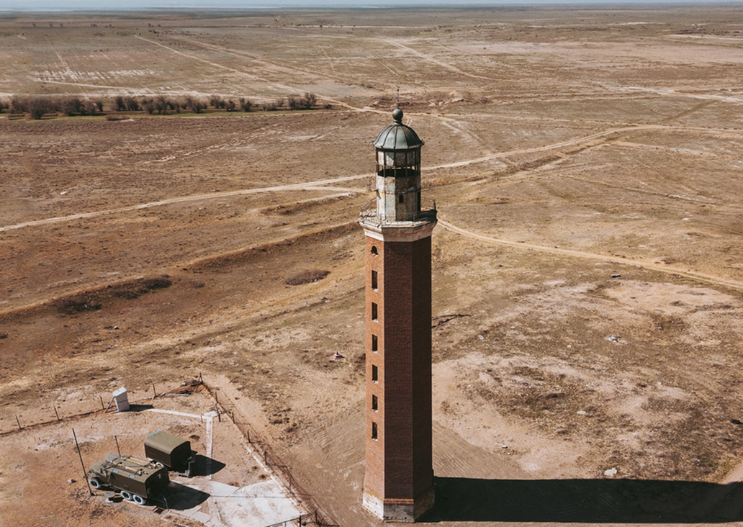
Thank you for your attention!

